Slide 1

DriverPass System Analysis
Christle Leary
Notes:
[No speaker notes required for this slide.]

Slide 2

System Requirements
Functional Requirements
Test and course status
modify appointments
Non-Functional Requirements
Updating
Performance
Notes:
For this example the functional requirements I chose were “Test and course status” and “modify appointments”. Two things that were a must in this system were the abilities for the student to see the status of their test and the courses they were taking on the main homepage when logging in. Another requirement was the ability to be able to modify their appointments using the system, allowing for ease of use.
The non-functional requirements I chose were “Updating” and “Performance”. While this might go hand in hand I chose to talk about them separately. For this example, I’m using “updating” to refer to the action of keeping the system up-to-date in regards to the DMV rules and regulations. It is imperative that the system update if any changes are made and search for any changes regularly. The system not being up to date in this regard could end in hefty costs not only for the company but for the students involved. “Performance” is important because in order for the system to run at its most efficient, the security and program must remain up to date. It is important that security is regularly updated and monitored to keep our users information safe. It is also important that changes that need to be made to the system to improve it are made quickly and efficiently.

Slide 3
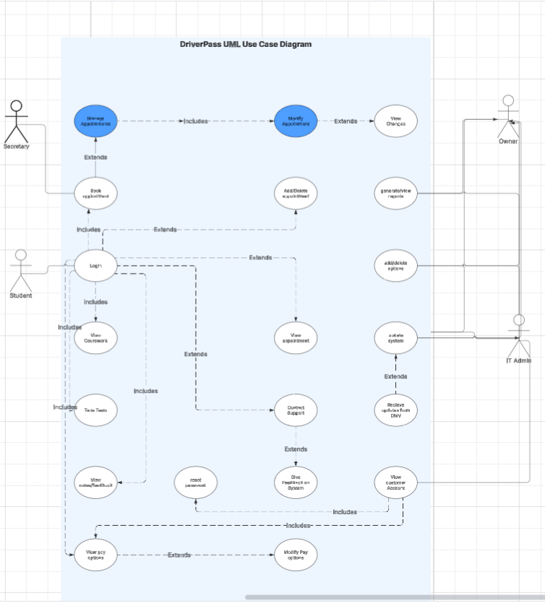
Use Case Diagram
[Insert your use case diagram here.]
Notes:
This diagram shows the users and how they will interact with the system. The users shown are “Secretary”, “Student”, “Owner” and “IT admin”. For this diagram, I have shown the separate things each person will be able to do on the system. For example, it shows the secretary has the ability to access the system to create and modify the appointments. It also shows how the student has access to that system but also can access things such as their courses, tests and information using their login. It also shows how the IT Admin and Owner have different access compared to the others.

Slide 4
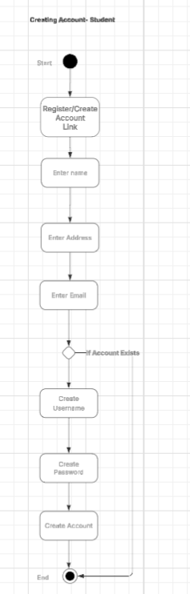
Activity Diagram
Notes:
In this diagram, I decided to show the process of a student creating an account. I have shown the student clicking a link to register the account. The system then asking for their name, address and email to verify their identity. The system then, in the background, checks to see if the account already exists containing this information. If it does, it skips to the end and informs the student that their account already exists, therefore giving them the login screen. If the account does not exist, then it continues to creating a secure username and password that the student can use to access the system. This ends with the account being created and the student now having access to their version of the system.

Slide 5
Security
Verification
Database security
Up-to-date system
Notes:
Security is incredibly important in any system, but especially in a system that houses private information such as credit card numbers. It is imperative that we have a system that verifies the user and only allows access to their portion of the database. On top of this, it is important that in the background, the database is a secure fortress that cannot be penetrated by those who wish to steal our users information. To do this, not only do we need to build a secure system but maintain it. Keeping security up-to-date is the most important thing we can do. It is important that the system regularly check for updates and updates are ran and incorporated into the system to keep up with changing and evolving trends in hacking. We are working with a system that not only has our users credit card information, but also will contain their address, name and driving history. This is all information that can be used against our users to steal their identities.

Slide 6
System Limitations
Technology
Budget
time
Notes:
Technology is a major limitation as we do not know what the company can afford to use as far as base computers and hardware. Technology can limit the system and cause it to run slow or inefficient. Budget plays into this as well. A firm budget will be needed to determine what the system needs to run within the companies capabilities. Time is the last limitation. Within the timeframe we have been given, we need to use our time effectively and efficiently. We need to split tasks and formulate a plan for design, testing and reformatting as needed.

